Slide 1
Computer Science and Robotics using the Raspberry Pi, Arduino, and other SBCs
Dr. Michael Walters and Dr. Kevin McCullen
SUNY Plattsburgh State
Computer Science

Slide 2
Outline
Why and How?
Some SBC’s
Practical Aspects
Configuration
Cost
Power
Transportation
Your toolkits
Software
Hardware
Challenges
Networking
Classroom Use
Servos
<TBD>
Show and Tell
OpenCV
Servos and Remote Control
Arduino
Adafruit Feather

Slide 3
Why? (so cheap)
Nick Tredennick 1995 Proceedings of the IEEE
“Zero Cost” portion of the “Embedded Control Market” was 100% of the market
Free
Everything Else
He missed a few trends:
“Zero Power”: 0% of market (not true now)
“Zero Delay”: 0% of market (except HDTV!)
“Zero Volume”: Still 0% (YF-12 and Intel)
Tredennick, N., Technology and Business: Forces Driving Microprocessor Evolution, Proceedings of the IEEE, 83 (12), 1641-1652, 1995.

Slide 4
Because there are zillions
2008: Estimated 30 embedded devices per person in the Developed World
Microwave
Coffee Machine
Remote Control
Automobile ECM
Key fob
Programmable Thermostat
TV (HDTV is part of “Zero Delay”)
Oven
Refrigerator
Fitbit
Smartwatch
etc, etc, etc, etc
Ebert, C., Jones, C., Embedded Software: Facts, Figures, and Future, IEEE Computer, 42 (4), 42-52, 2009

Slide 5
… and cheap computing enables
Hands On Learning
Sense-Compute-React
Low-level programming

Slide 6
Example SBCs
Raspberry Pi
Arduino
Feather
C.H.I.P. (R.I.P.)

Slide 7
Raspberry Pi Essentials
What is it?
A family of credit-card sized (or smaller) computers
Since 2012
B, A, B+, A+, 2, Zero, Zero W, 3B, 3B+, Compute Module
Broadcom ARM SOC with GPU
Networking (depends on model)
Video (depends on model)
Audio (on full size units)
Powered by micro USB (5V)

Slide 8
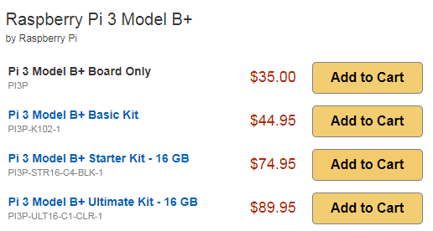
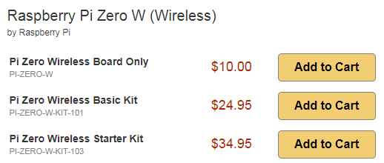
Raspberry Family
Model | Cores | Memory | Network | USB | Video | Audio | Camera Connector
Zero | 1 (1 ghz) | 512 MB | n/a | 1 micro | Micro-HDMI | n/a | Y
Zero W | 1 (1 ghz) | 512 MB | Wifi + BLE | 1 micro | Micro-HDMI | n/a | Y
1A+ | 1 (700mhz) | 256 MB | n/a | 1 std | HDMI | Stereo | Y
2B | 4 (900mhz) | 1 GB | Ethernet | 4 std | HDMI | Stereo | Y
3B | 4 (1.2ghz) | 1 GB | Wifi + Eth + BLE | 4 std | HDMI | Stereo | Y
3B+ | 4 (1.4ghz) | 1 GB | Wifi + Eth + BLE | 4 std | HDMI | Stereo | Y
www.canakit.com, retrieved April 16, 2018

Slide 9
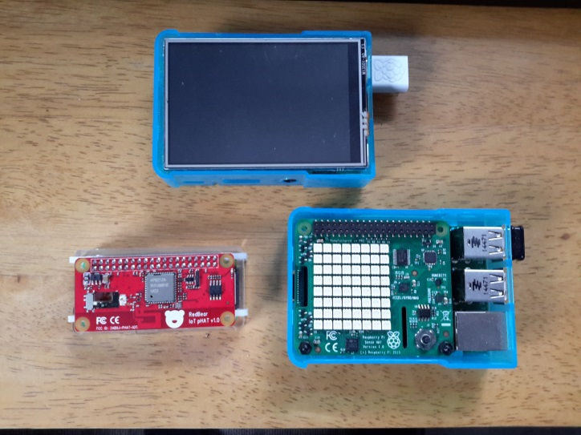
The “Hats” are huge!
The GPIO (aka “Header”) allows plugging peripherals onto the Pi
The header exposes pins for:
Serial
SPI
I²C
PWM (pulse width modulation)
One-wire (Dallas/Marvel Semiconductor)
Three Pi systems with Hats:
RPi Zero: Wifi / Bluetooth
RPi 2: TFT / Touch Screen
RPi 2: Sense HAT

Slide 10
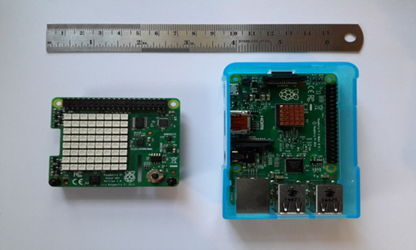
The Sense HAT
Created for the ISS “Astro PI” mission
Includes:
Temperature
Humidity
Pressure
3 DOF Magnetometer
3 DOF Accelerometer
3 DOF Gyroscope
5 position (l, r, u, d, press) joystick
8x8 multi-color LED array
All programmed using a Python API
For about $35

Slide 11
Raspberry Pi Summary
A full Linux system
What’s missing:
Powered USB hub (notorious for low USB drive)
Power supply (Std 5V USB)
Micro-sd card (8 GB or larger)
Keyboard, Mouse, Display
Micro-HDMI to HDMI for Zero and Zero W
It’s not $30 anymore
What can you do?
Image processing, Networking (used for Network Security classes), Arcade emulators, Cameras ($25 camera option), Web server, Sensor data collection, Kiosks, Interface to Lego Mindstorms sensors and servos, etc, etc.
We teach Embedded Systems Programming and Robotics using Raspberry Pi
One cool thing … if you mess up, you can reflash your micro-SD and start over (nice for lab setups)

Slide 12
What’s the Arduino?
An Embedded System development board
AVR 8 bit microcontroller (on basic Uno model)
16 Mhz
32 KB flash memory (up to 512 KB)
2 KB SRAM (up to 96 KB)
Programmed in C, cross compiled and downloaded
Uses “Shields” (just like Raspberry Hats)
Named after a pub … near a design school in Italy, the Bar Di Re Arduino
Open Hardware (!) and Software

Slide 13
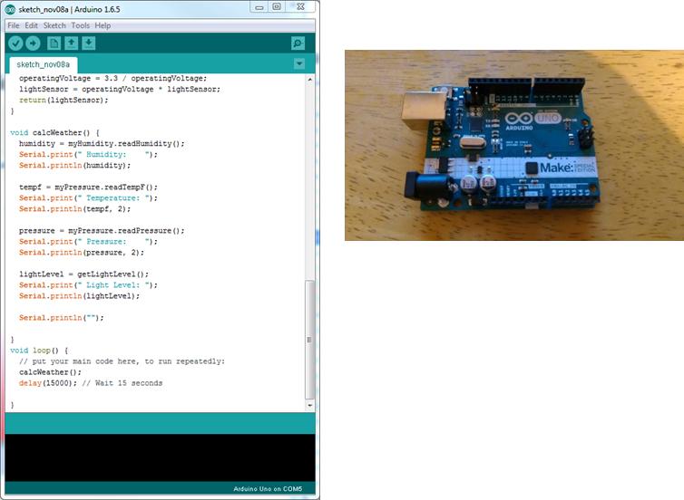
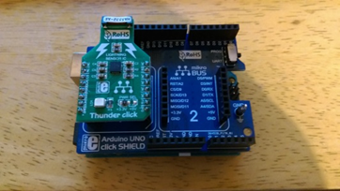
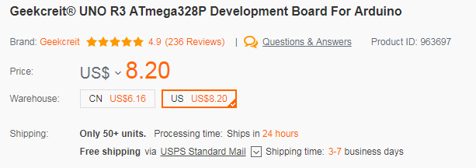
Arduino and a Shield
Cross-Compiled on
Windows
Direct from China … almost free
www.banggood.com, retrieved April 16, 2018

Slide 14
What do you do with Arduino?
shieldlist.org lists 317 Arduino shields:
Sensors
Servos
Audio (including audiophile DACs)
NFS
Bluetooth
Wifi
Data logging
Real Time Clock
Guitar Stomp box (DSP shield)
Touchscreen
NIXIE tubes
RFID
Keyfob receiver
GSM (cellphone data)
Lightning Strikes
Unlike the Raspberry, Arduino shields
are often “stacked.”
As long as the chip select or I²C addresses
don’t conflict, multiple shields can be
used.
Your challenge is to program in the limits
(32KB for an Uno … hard to get all of the
Libraries included.)
For a networking class, I stacked:
Weather sensor shield
Ethernet shield
2x14 char LCD display

Slide 15
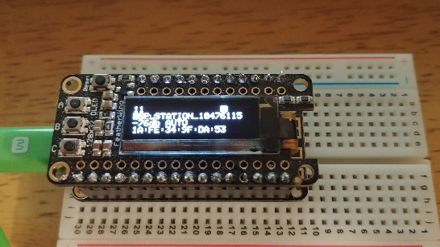
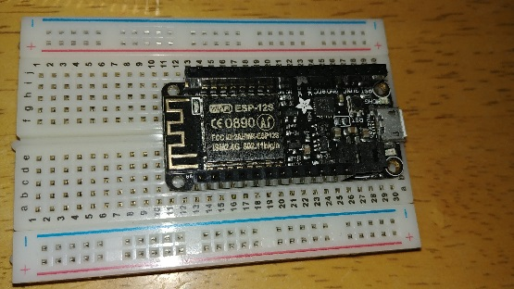
Adafruit Feather
Adafruit Feather: $22 w/ wifi and BLE
ESP32
Can run off a LiPoly battery (i.e. what drones use)
GPIO with I²C and SPI
Programmable through the Arduino development
environment, or directly through a com port.
Comes with NodeMCU LUA flashed
240 Mhz microcontroller
520 KB SRAM
Wifi + BLE
4 MB flash

Slide 16
I²C
What is I²C, and why do we keep mentioning it?
It’s a serial bus protocol used extensively by the sensors on Raspberry, Feather, and Arduino systems.
You “talk” to the sensors one byte at a time reading and writing registers with hex addresses on the sensor chip.
This code checks if the Sense HAT’s HTS221 temperature sensor is ready to return data: int32_t devFD = wiringPiI2CSetup(0x5F); // 0x5F is the HTS221’s hardwired code int32_t retcode = wiringPiI2CWriteReg8(devFD, 0x20, 0x87); retcode = wiringPiI2CWriteReg8(devFD, 0x10, 0x1B); uint8_t status = wiringPiI2CReadReg8(devFD, 0x27);
The I²C and SPI (a similar protocol) are directly accessible in C or Python on the RPi, in C on the Arduino and Feather.
This is how you talk to sensors.

Slide 17
You may be soldering
Many (if not most) of the shields or hats do not come with headers installed.
You’ll probably need to solder on the headers
You many need to purchase the headers
Eventually you’ll have a little drawer full of various size headers ready to solder
I only wish copper braid for cleaning up solder had existed when I was a student

Slide 18
Practical Aspects

Slide 19
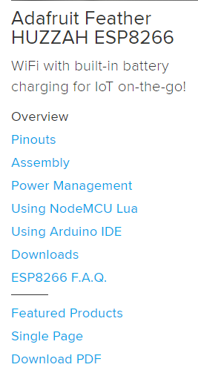
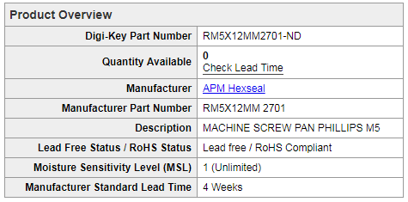
Suppliers
Adafruit (great tutorials and samples)
Sparkfun
RobotShop
ControlEverything
MakerShed
Element 14
Digikey (serious part supplier)
i.e. I need 12 mm stainless steel screws with M5 threads
Mouser (another serious part supplier)
https://learn.adafruit.com/adafruit-feather-huzzah-esp8266 retrieved April 16, 2018
https://www.digikey.com/products/en/hardware-fasteners-accessories/screws-bolts/572?k=stainless%20m5 retrieved April 16, 2018

Slide 20
Configuration
The Arduino and Feather are plug-and-play
But the Raspberry Pi is something different
A complete Linux System
You have two choices:
(A) Build an image ahead of time
(B) Have your students configure the system
Option (A): You get off the ground a lot quicker
Option (B): The students get more experience

Slide 21
What’s in the Configuration?
Start with a base Linux
NOOBS (New Out Of the Box Software)
OS Installer for the Raspberry Pi
Installs RASPBIAN
Available pre-installed on a micro-sd
Downloadable (1.3 GB)
RASPBIAN
Download Lite (350 MB) or full (1.7 GB)
Unzipped

Slide 22
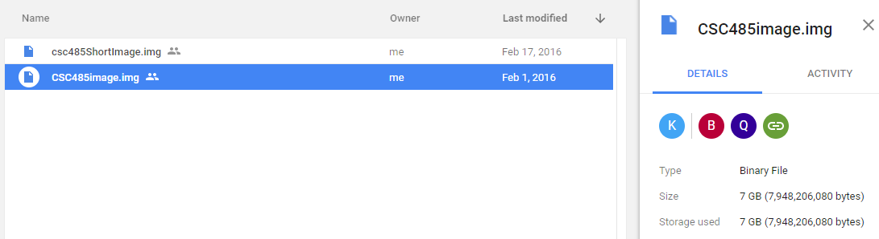
Just add software …
Set up the configuration and install your customization.
For example, for the SenseHAT
sudo apt-get update
sudo apt-get install sense-hat
sudo shutdown –r now
For each package you need … lather-rinse-repeat (a number of times)
You can go through the entire configuration process, test it, and then store the micro-sd image (if you have room somewhere)
Students can download the image and flash it to their micro-sd card

Slide 23
Caveat Emptor
Two things to consider:
You built an image on an 8 GB micro-sd card. Is your 8 GB micro-sd the same size as your student’s? Each brand may be slightly different, and you can’t (easily) shrink the image.
How do you do personalization after the image is flashed?
You can use SSH or VNC after you get the IP address (more later)
You might want to consider offering a few “Raspberry Stations” in your lab: HDMI display, USB keyboard, USB mouse. (Verify that the mouse and keyboard work with the RPi, work is sometimes necessary to get a keyboard recognized)

Slide 24
Cost
Once you’ve added the ancillary requirements, you’re not really talking about a $20 or $30 expense.
Beware of Chinese vendors. The shipping times might be much longer than your students expect.
They may order from Amazon and not check closely who they’re ordering from.
There’s no PDF they can download free …
Your bookstore needs to figure out how to order the required parts in order for financial aid to cover the hardware.

Slide 25
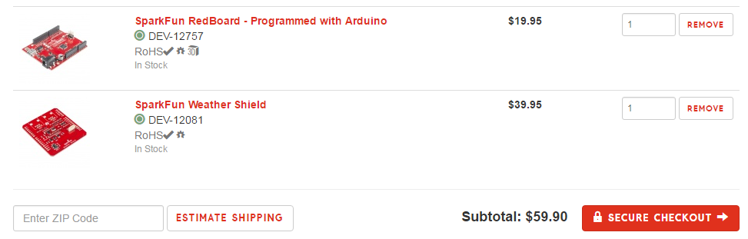
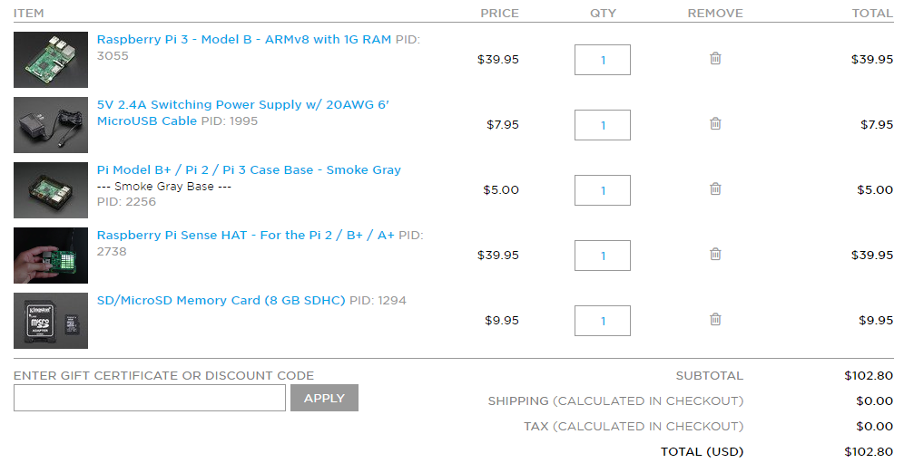
Not necessarily cheap

Slide 26
Power
Power supply or cellphone charger?
For use in the classroom, a cellphone charger works better (don’t need 20-30 outlets)
10,000 mAh charger should run an RPi 3B+ (2.5A draw) for about four hours.
Servos need separate power (especially with Raspberry Pi). Connection via wire or barrel plug to a battery pack (9V) is recommended.
So that’s two power supplies for each system.

Slide 27
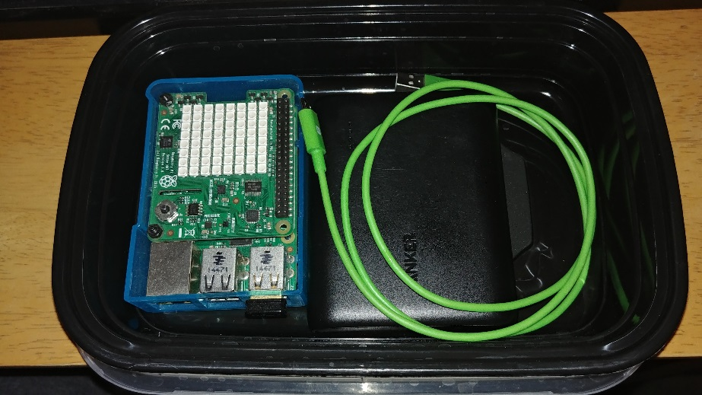
Transportation
You don’t want the hardware rattling around in backpacks …
A Chinese food container works very well. Provides some protection during transportation.
A case and stand offs for shields help to protect the hardware.

Slide 28
Your Toolkits
Software
VNC
To get a remote desktop for an RPi
PuTTY
For connecting to RPi and Adafruit Feather
WinSCP (or Apple equivalent)
For copying files between an RPi and host computer.
Win32DiskImager (or Apple equiv)
For writing images to the micro-sd cards.
Arduino GUI and libraries
Many shields require installing additional libraries
ADAFruit Feather requires installing a different base library
Hardware
Soldering Iron/Flux/Copper Braid/Solder
Many of the shields and boards come without headers installed.
Screwdrivers
Pliers
Battery Pack
Volt meter
Cables … of every type
HDMI
USB
A connects to your PC
B connects to Arduino
2.0 micro connects to RPi
Need A-B and A-micro minimum
Micro-sd to USB-A to flash images
Headlamp
For seeing small things with old eyes

Slide 29
Challenges
Nation Robotics Challenge (NRC): Located in Marion, Ohio
All age ranges. Middle school through college
Many different challenges for different skill sets
Autonomous
Mazebots
IoT
Sumo
“Battlebots”
Trinity College Fire Fighting Home Robot Contest:
Located in Hartford, CT
All age ranges. Elementary school through college
Put out candles autonomously
More contests at https://robotics.nasa.gov/events/competitions.php

Slide 30
Availability
Latest/Hottest/Coolest Raspberry Pi are always limited availability
SenseHAT went in and out of stock
Has been in stock at Adafruit since Nov 10th
Standoffs were out of stock for a while

Slide 31
Networking
First attempt:
Linux laptops on wireless
Direct ethernet (bridged) to Raspberry Pi
Proved complicated. Laptops had to be taken off wired and then connected to wireless using scripts.
But that was with Raspberry Pi 2 models, without built in Wifi and Bluetooth.

Slide 32
Networking
Raspberry Pi 3 models have built in Wifi.
Getting online with a corporate-style WPA can be difficult.
I haven’t used a network that requires a login through a website yet.
Your mileage will vary, but this configuration works with our campus configuration (in /etc/wpa_supplicant/wpa_supplicant.conf): ctrl_interface=DIR=/var/run/wpa_supplicant GROUP=netdev update_config=1 country=US network={ ssid=“HomeNetwork“ psk=“ReallySecure“ key_mgmt=WPA-PSK } network={ ssid="SUNY-Plattsburgh“ #scan_ssid=1 proto=WPA RSN key_mgmt=WPA-EAP IEEE8021X pairwise=CCMP TKIP group=CCMP TKIP auth_alg=OPEN LEAP eap=PEAP identity=“useridForMe“ password=“ReallyReallySecure“ }

Slide 33
Great, now you’re online
That actually doesn’t help you too much …
How do you find the system on the network?
Presumably you want to connect to it …

Slide 34
Which brings us to …
How to use the system in the classroom.
Arduino and Feather are easy. Plug in to a laptop or desktop (either a lab system or the student’s) and go. The GUI runs on Windows, Linux, and the Mac.
But what about a Raspberry Pi?

Slide 35
Using a Raspberry Pi in the lab
Student plugs in Raspberry Pi
Typically from a battery pack (cellphone charger)
Raspberry Pi boots up and must:
Start a remote desktop (VNC)
Find its IP address and tells the student (Python -> Twitter)
Student can use VNC from a lab system or laptop to connect to the Raspberry Pi and run their program.

Slide 36
Starting the required software
Use the @reboot feature of Crontab:
# Edit this file to introduce tasks to be run by cron.
#
# Each task to run has to be defined through a single line
# indicating with different fields when the task will be run
# and what command to run for the task
#
# To define the time you can provide concrete values for
# minute (m), hour (h), day of month (dom), month (mon),
# and day of week (dow) or use '*' in these fields (for 'any').#
# Notice that tasks will be started based on the cron's system
# daemon's notion of time and timezones.
#
# Output of the crontab jobs (including errors) is sent through
# email to the user the crontab file belongs to (unless redirected).
#
# For example, you can run a backup of all your user accounts
# at 5 a.m every week with:
# 0 5 * * 1 tar -zcf /var/backups/home.tgz /home/
#
# For more information see the manual pages of crontab(5) and cron(8)
#
# m h dom mon dow command
@reboot export USER="pi";export HOME=/home/pi;tightvncserver >> /home/pi/reboot.log 2>&1
@reboot sleep 30;cd /home/pi;python3 tweetIPAddress.py >> /home/pi/reboot.log 2>&1

Slide 37
Using Twitter
There is a Python API for Twitter
Actually, there are several. This is just one method.
Using Twitter direct message
Only the recipient will see the message.
Add a sequence number
Otherwise if the IP address doesn’t change Twitter thinks the message is a duplicate and rejects it.
You’d know it was the same as the last time … but might not remember the old IP address.

Slide 38
Connecting to Twitter
This page is where you generate the tokens: https://developer.twitter.com/en/docs/basics/authentication/guides/access-tokens
The python library I'm using is this one: https://pypi.python.org/pypi/twitter
The following code is derived from the examples at pypi’s twitter page

Slide 39
Using Twitter to send IP
from twitter import Twitter, OAuth
import subprocess
from datetime import datetime
try:
fileVar = open("/home/pi/lastTweetSeq.txt", "r")
lastTweet = fileVar.read()
lastTweetSeq = int(lastTweet) + 1
fileVar.close()
except FileNotFoundError:
lastTweetSeq = 0
fileVar = open("/home/pi/lastTweetSeq.txt", "w")
fileVar.write(str(lastTweetSeq) + "\n")
myIP = subprocess.Popen("hostname -I", shell=True, stdout=subprocess.PIPE).stdout.read()
myIPstr = str(myIP.strip())
myIPstr = myIPstr.replace("'","").replace("b","")
print(str(datetime.now()) + " " + myIPstr)
tweet = 'Raspberry Pi connected at ' + myIPstr + " (" + str(lastTweetSeq) + ")"
token="xxxx"
token_secret="xxxx"
consumer_key="xxxx"
consumer_secret="xxxx"
twitter = Twitter(auth=OAuth(token, token_secret, consumer_key, consumer_secret))
twitter.statuses.update(status=tweet)
twitter.direct_messages.new(user="uuuu", text=tweet)

Slide 40
Connect with VNC
Once you receive the Twitter direct message, you can use VNC Viewer to connect to the Raspberry Pi
Now you have a virtual desktop onto the RPi.
There is another method that’s just popped up online. You can use SSH over Bluetooth.

Slide 41
Servos, Arduino and Raspberry

Slide 42
Motors
PWM : Pulse Wave Modulation
More efficient then running the motor at half power.
Pulses the motor at full power for a percentage of the time, allowing it to look like it is running at a lower power.

Slide 43
Steppers
Motors with positional awareness
Move in precise rotations per pulse
Can be used in a continuous mode
Has a built in brake

Slide 44
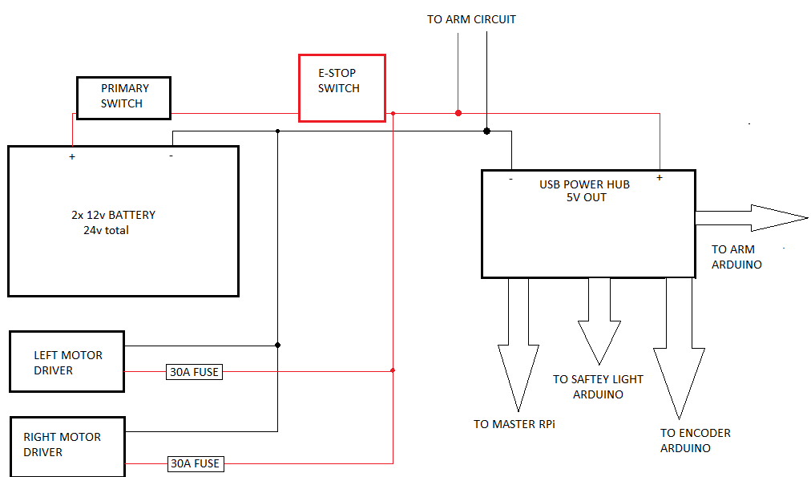
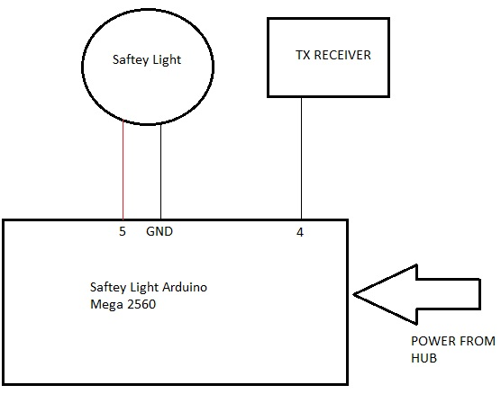
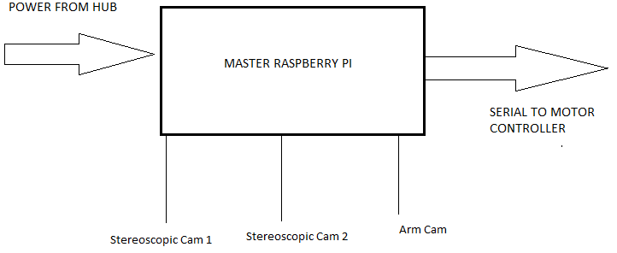
Redneck Rover

Slide 45
Example Arduino Servo Code
void moveMotors(){
//set motor direction
if (PIDParameters[6]<0){
digitalWrite(dirpinL, LOW);
}
else{
digitalWrite(dirpinL, HIGH);
}
if (PIDParameters[7]<0){
digitalWrite(dirpinR, LOW);
}
else{
digitalWrite(dirpinR, HIGH);
}
else {
leftMotorPower = int(abs(PIDParameters[6]));
rightMotorPower = int(abs(PIDParameters[7]));
}
if (leftMotorPower > 250) { //limit the motor power to half for testing
leftMotorPower = 250;
}
if (rightMotorPower > 250) {
rightMotorPower = 250;
}
analogWrite(pwmpinL,leftMotorPower);
analogWrite(pwmpinR,rightMotorPower);
}

Slide 46
Example Raspberry Pi Servo Code
def moveServoRange(rate, start, stop, servo):
midPoint = int((start + stop)/2)
for i in range(midPoint, stop):
servoVal = stop + i*2
pwm.set_pwm(servo, 0, servoVal)
time.sleep(rate)

Slide 47
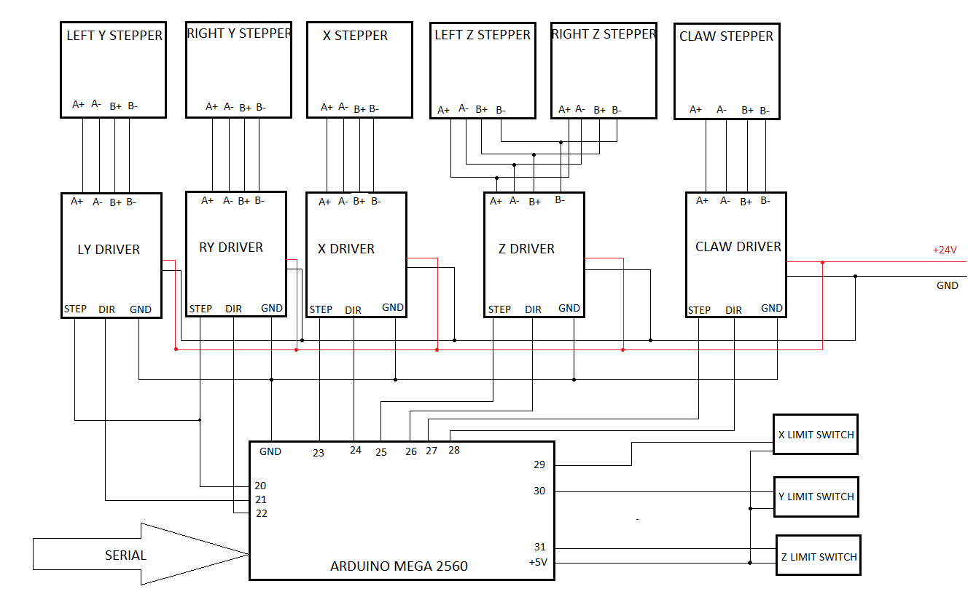
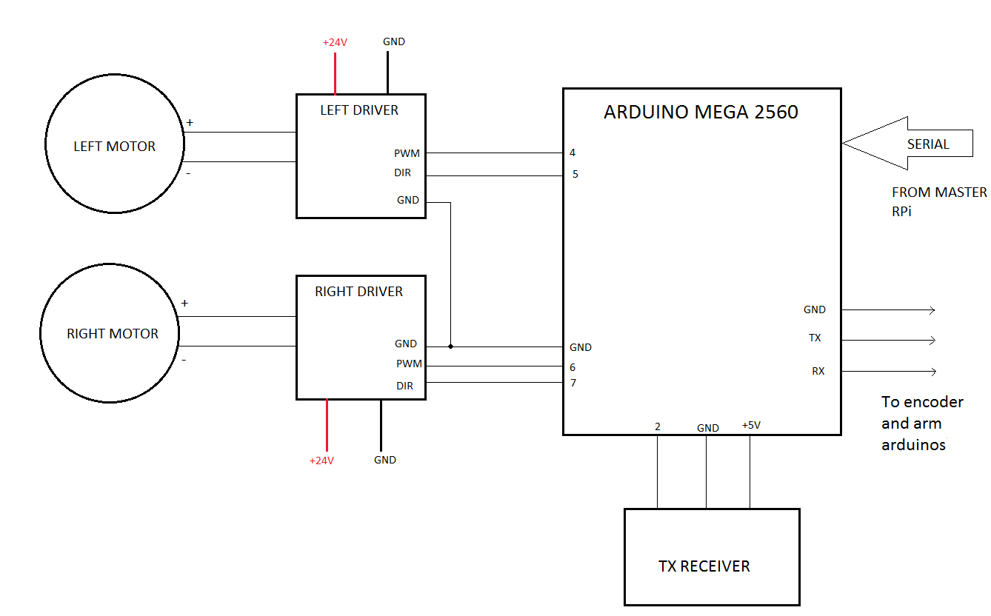
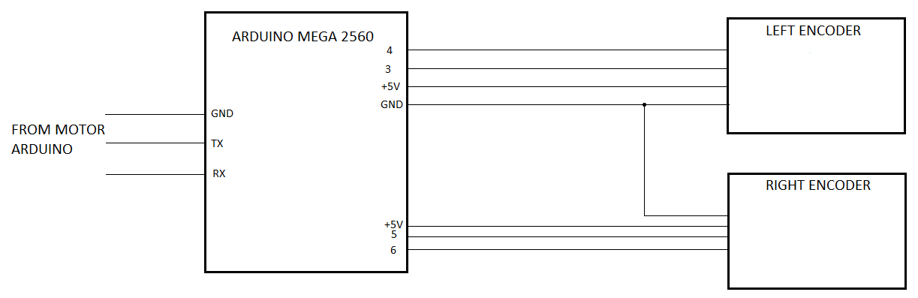
Redneck Rover

Slide 48
Redneck Rover

Slide 49
OpenCV
Challenging to install!
Makes doing vision easier
Lots of tutorials
https://www.pyimagesearch.com/
I found a purple rock, but you need to trust your own eyes

Slide 50
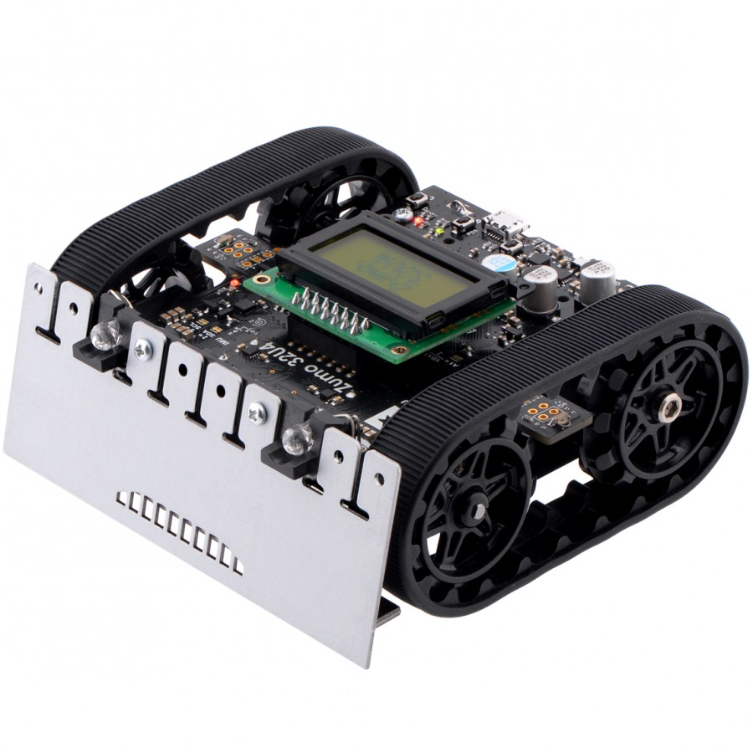
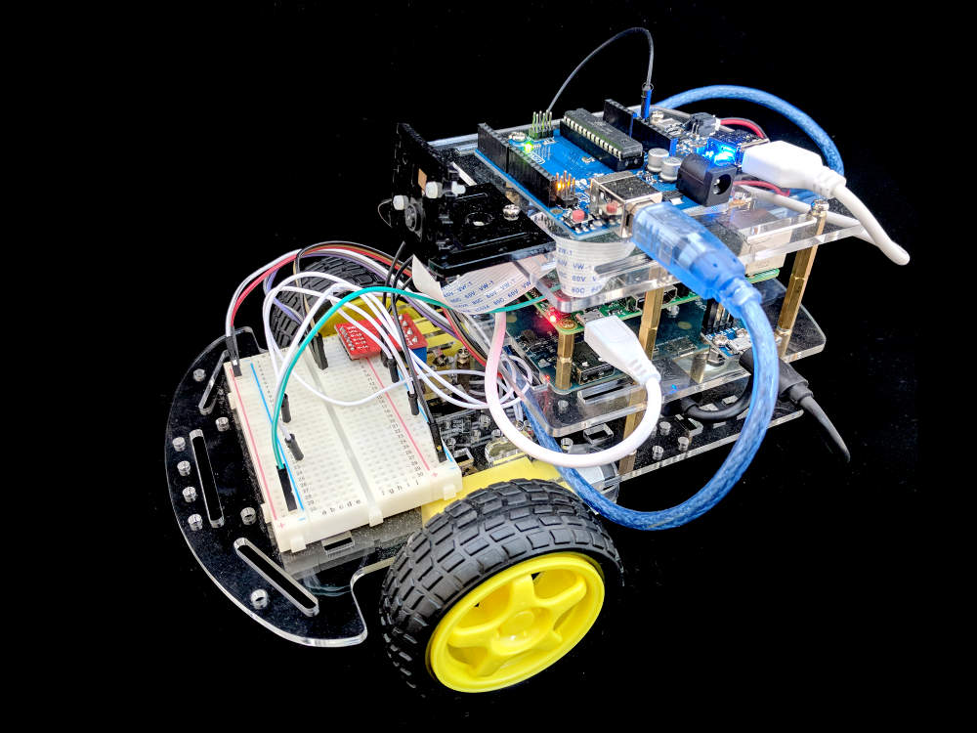
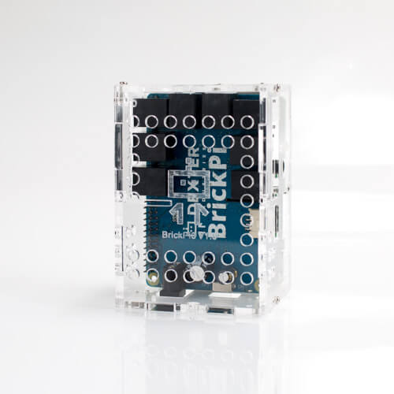
Commercial Products
Zumo
ROSbot
BrickPi

Slide 51
Final Thoughts

Slide 52
You will become one with Google
For example, installing OpenCV on the Pi Zero:
Many, many steps
Pieces from multiple different sources
None of these systems are 100% bulletproof
RPi: low USB current, makes keyboards flakey
RPi: low HDMI drive, requires changing the configuration in /boot to stop display from blanking.

